Slide 1
Network Overview
At Dublin Business School

Slide 2
Network Overview
Introduction to Networking
Network Implementations
Network Topologies
Network Connectivity
Reference Models

Slide 3

Networking: An Introduction
What is Computer Networking?
The interconnection of two or more computing devices for the purpose of sharing resources and exchanging data

Slide 4
NETWORKING: AN INTRODUCTION
To enable the communication of computing devices across a network, there are three requirements:
Physical Devices to generate/transmit the signal
Network Interface Card (NIC), Modem, Cables
Logical Rules
Protocols, Encoding, Encapsulation
Software to interpret the protocol and display the data in the required format
Web Browser

Slide 5
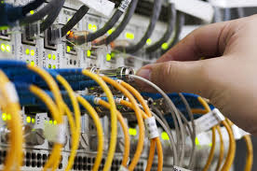
NETWORKING: AN INTRODUCTION
A protocol is a formal description of a set of rules and conventions that govern how devices on a network communicate
IP: Internet Protocol
Protocols determine:
Timing
Sequencing ○
Error Control

Slide 6
Wide Area Network (WAN)
WAN stands for Wide Area Network
One large network that covers a large geographic area.
Internet – best known WAN
Typically many smaller networks linked into one large network
Called an enterprise network when owned by one organisation
In general, routers (and switches) connect disparate networks to form a WAN

Slide 7
METROPOLITAN AREA NETWORK (MAN)
Stands for Metropolitan Area Network
Uses the same technology set as WANs
A MAN is much smaller than a WAN
A MAN may cover an area up to 50km (give or take)
In most circumstances, the term WAN is typically used in place of MAN
Hence, WAN implies both WAN and MAN

Slide 8
LOCAL AREA NETWORK (LAN)
LAN stands for Local Area Network.
Limited in size.
Can be as small as a single room or as big as a building.
A LAN may also span several buildings close together

Slide 9
LOCAL AREA NETWORK (LAN)
TIA/EIA 568-C standard defines characteristics of LANs
Normally uses twisted pair cabling to connect devices
Should use CAT 6 or 6a in current LAN builds
This will help future proof a network installation
Hierarchical star is the only topology recognised by 568-C
LAN nodes are tied together with switches or hubs
It is possible to use fibre-optic cables to connect switches

Slide 10
WIRELESS LANS (WLANS)
WLAN stands for Wireless Local Area Networks.
It is a standard LAN that uses wireless technologies
The WLAN technologies are often collectively referred to as Wi-Fi
Wi-Fi technologies are defined by the IEEE 802.11 standard
IEEE 802.11ac – is one the most common Wi-Fi standard in use.
However, the IEEE 802.11ax standard is gaining popularity

Slide 11
PERSONAL AREA NETWORK (PAN)
PAN stands for Personal Area Network
Defined by the IEEE 802.15 standard group
Note: it is not the same wireless standards as wi-fi
Primarily uses Bluetooth technologies for connecting
Limited range of less than 30 feet.
Useful in terms power consumption
Devices like keyboards and mice can use PANs to connect to a computer.
Also - phone accessories, earbuds, smart watches, Infrared (IrDA)

Slide 12
Network Topologies
We will consider the following topologies:
Mesh
Star
Peer-to-Peer
Client-Server

Slide 13
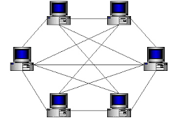
Mesh Topology

Slide 14
Full Mesh
Full Mesh
All devices are directly connected to each other
Provides full redundancy
Most expensive type of topology
Requires multiple NICs and cables for each node
Most likely to be found in a WAN environment

Slide 15
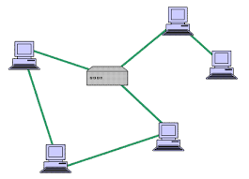
Partial Mesh

Slide 16
Partial Mesh Topology
All devices directly connected to at least two other devices
Provides strong redundancy but not full redundancy
Not as expensive as a full mesh
Multiple NICs and cable runs on each machine
Most likely found in a WAN environment
The Internet is a partial mesh.

Slide 17
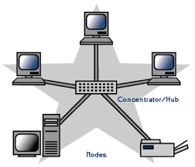
Hierarchical Star Topology

Slide 18
Star Topology
Most common topology used in LANs
Won’t bring down the network with one damaged node
All nodes connected to a central hub or switch
Easy to troubleshoot

Slide 19
Star Topology
It’s susceptible to a single point of failure.
If the whole network goes down, the central device is a problem.
If only a single node goes down, that node is the problem.

Slide 20
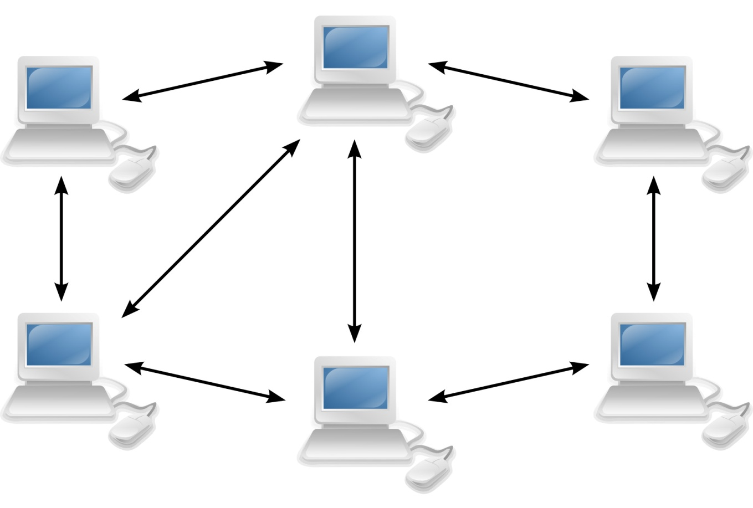
Peer-to-Peer

Slide 21
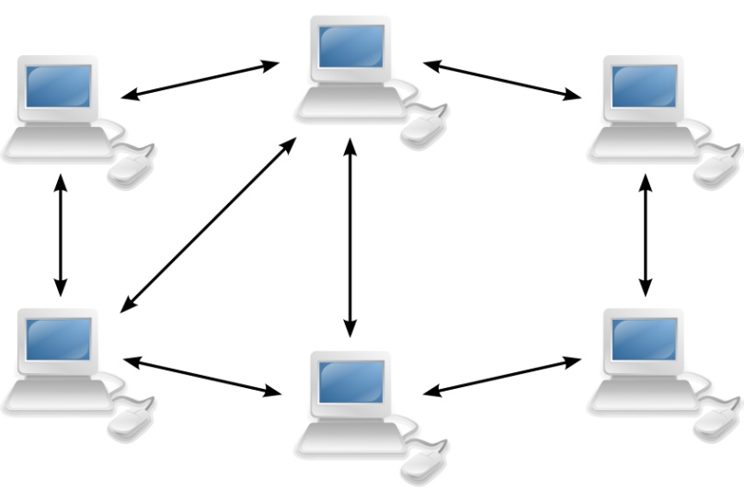
Peer to Peer
Each computer is responsible for its own security and management
Each computer is managed as a separate device
Therefore, management is built around individual computers
Usually only used for very small networks
A Microsoft peer-to-peer network is limited to 10 systems per network
Homegroup and Workstation are peer-to-peer

Slide 22
Peer to Peer
It is typically used in a small business of two or three computers.
Most home networks are peer-to-peer model.

Slide 23
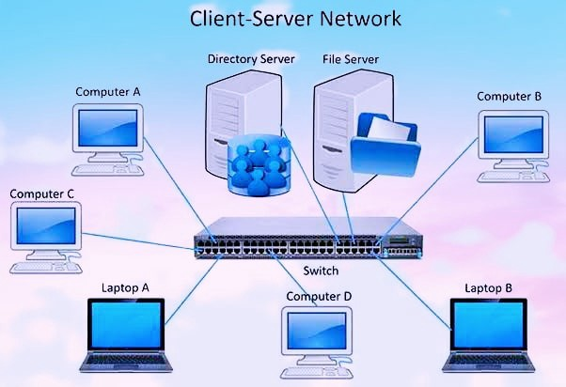
Client Server Network

Slide 24
Client Server
All devices access resources through a central server
Devices needing access to the network are called Clients
A Client consumes services / resources
Devices (or device) controlling access are called Servers
A Server provides services / resources for consumption

Slide 25
Client Server
Network management is overseen by a server,
Authentication, Printing, Storage, Anti-Virus … etc
Security is built around access to the server
The Server allows or restricts access to network resources.
The Server controls who is allowed to log on to the network.
If the server goes down, no one is able to access the network.

Slide 26
COMPUTER PORTS
A virtual point where network connections start and end between two communicating device is known as a PORT.
CHARACTERISTICS
Ports are software-based and managed by a computer's operating system.
Each port is associated with a specific process or service.
Ports allow computers to easily differentiate between different kinds of traffic: emails go to a different port than webpages, for instance, even though both reach a computer over the same Internet connection.

Slide 27
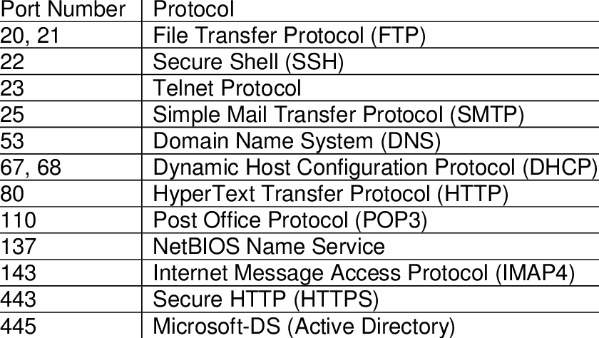
COMPUTER PORTS
Ports are standardized across all network-connected devices, with each port assigned a number. Most ports are reserved for certain protocols — for example, all HTTP messages go to port 80. While IP address enable messages to go to and from specific devices, port numbers allow targeting of specific services or applications within those devices.

Slide 28
Network Protocols
A protocol is a set of rules for formatting and processing data. Network protocols are like a common language for computers. The computers within a network may use vastly different software and hardware; however, the use of protocols enables them to communicate with each other regardless.
EXAMPLES OF PROTOCOLS USED ON THE INTERNET
HTTP, HTTPS, TCP, UDP, TLS/SSL
Display network status and protocol statistics using netstat command
Identify the difference between standard and Non-standard ports

Slide 29
Socket
A socket is one endpoint of a two-way communication link between two programs running on the network. A socket is bound to a port number so that the TCP layer can identify the application that data is destined to be sent to.
Socket = IP Address + Port Number
DEMO
Explore using netcat to send messages
Install nc : yum install nc –y
nc –lv 8888 (server)
nc host port (client)

Slide 30
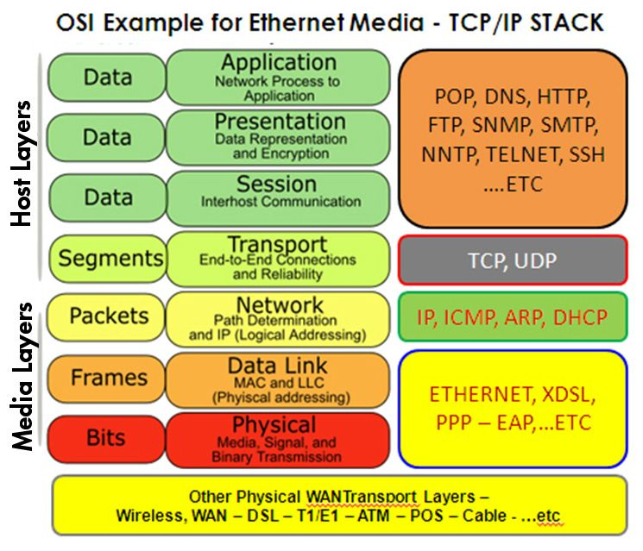
Reference Models
Reference models are used to standardise and describe the communications process.
The process is broken-up into layers and each layer has a particular role to play.
Typically, there is a protocol associated which each layer which is responsible for executing this role.
Examples include:
OSI
TCP/IP

Slide 31
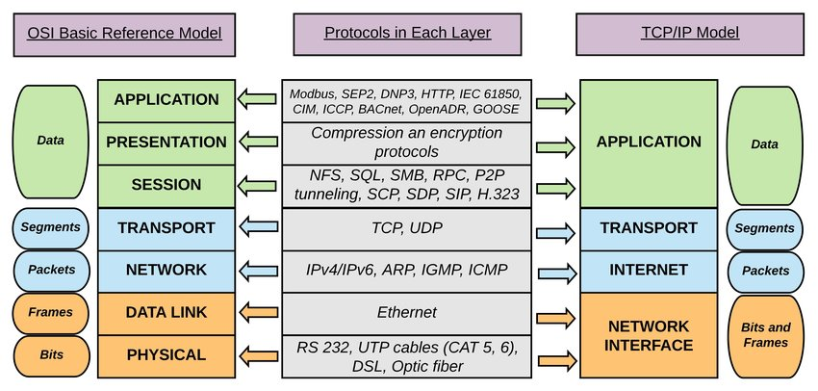
TCP/IP Model

Slide 32
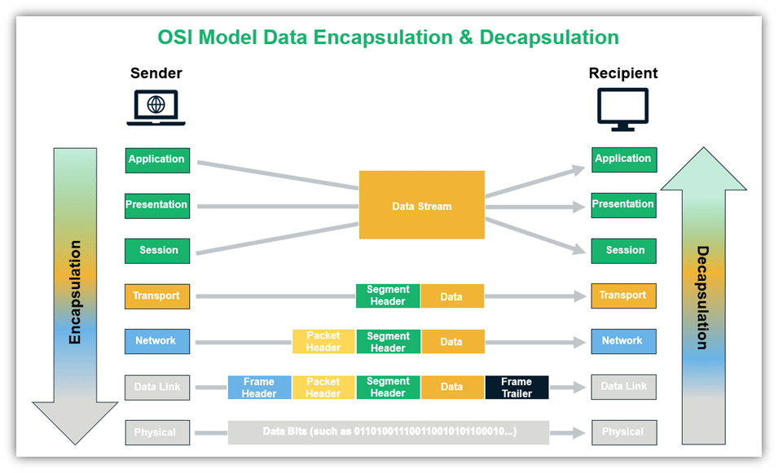
Data En/(DE)-capsulation
As the data travels down from the application layer of your computer, additional information gets added to the data before it is passed on to the layers below. This process is called data encapsulation because it involves adding protocol information to the beginning (header) and/or end (trailer) of the data.
At the recipient’s end, data decapsulation takes place where the incoming data is unpacked as it moves up the layer till finally, at the application layer, all the additional headers and/or trailers added are stripped off.
https://www.youtube.com/watch?v=6Aw4mTv7CYY

Slide 33
TCP/UDP
TCP – Transmission control protocol is a Layer 4 connection-oriented protocol that enables application programs to exchange messages over a network.
Consider TCP as a puzzle assembler, the client writes a message which is broken into smaller pieces. Each piece then can travel through a different postal route, some of which take longer than others. When the puzzle pieces arrive after traversing their different paths, the pieces may be out of order. The Internet Protocol makes sure the pieces arrive at their destination address. TCP puts the pieces together in the right order, asks for missing pieces to be resent, and lets the sender know the puzzle has been received.

Slide 34
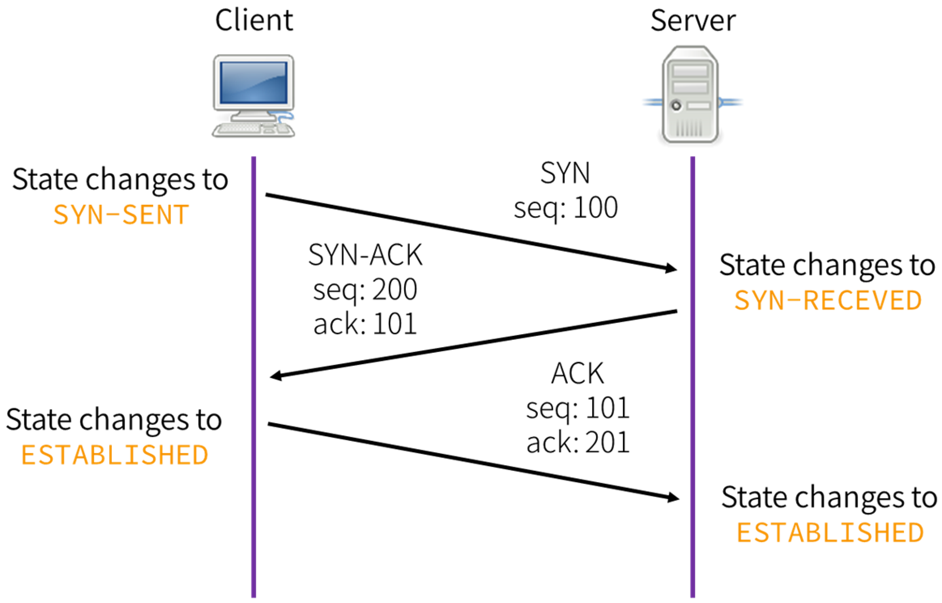
TCP 3-WAY HANDSHAKE
When an email is sent over TCP, a connection is established, and a 3-way handshake is made.
First, the client send an SYN “initial request” packet to the target server in order to start the dialogue. Then the target server then sends a SYN-ACK packet to agree to the process.
Lastly, the source sends an ACK packet to the target to confirm the process, after which the message contents can be sent. The email message is ultimately broken down into packets before each packet is sent out into the Internet, where it traverses a series of gateways before arriving at the target device where the group of packets are reassembled by TCP into the original contents of the email.

Slide 35
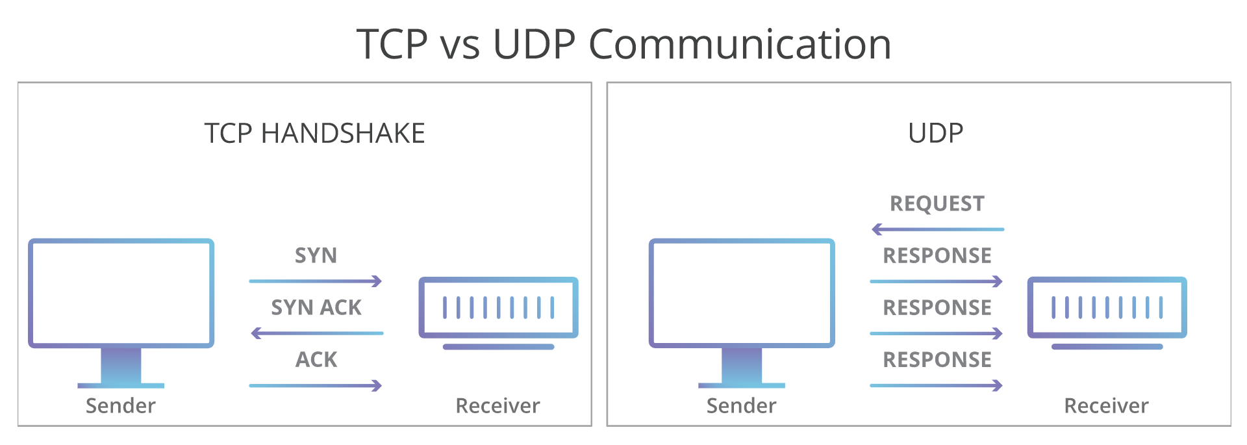
UDP
UDP - The User Datagram Protocol (UDP) is a communication protocol used across the Internet for especially time-sensitive transmissions. It speeds up communications by not formally establishing a connection before data is transferred.
This allows data to be transferred very quickly, but it can also cause packets to become lost in transit.
Where occasionally dropping packets is better than waiting UDP can be used e.g Voice (Voip) and video traffic

Slide 36
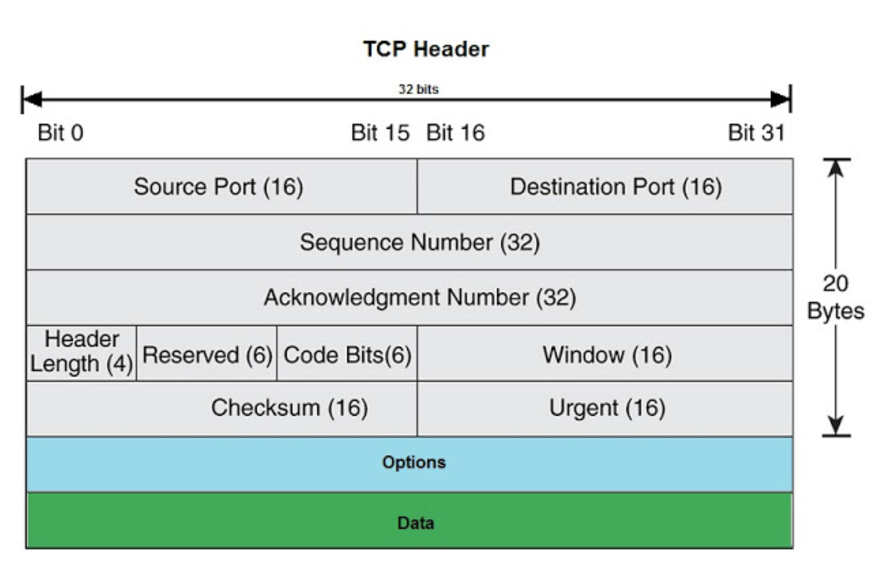
TCP HEADERS
Source/Destination port: 16-bit field that specifies the app port number of the host sending the data and destination host.
Sequence number: It is a 32-bit field that is used to put the data back in the correct order and also used to re-transmit missing or damaged data segments.
Ack number: 32-bit field that is used by the receiving host to acknowledge the successful delivery of segments based on which the next stream of data segments is sent by the source.
Header Length(HLEN): a 4-bit field that defines the number of 32-bit words in the header. This field also indicates the length of the TCP header so that we know where the actual data begins.
Reserved: It is a 3 bits field with value always set to 0.
Window: It is a 16-bit field that is used to negotiate the window size b/w sending and receiving hosts.
Checksum : It is a 16 bits field that is used for integrity checks TCP segment.
Urgent Pointer: It is a 16 bits field that indicates the end of urgent data. This field is used when the URG bit is set in Code bits(flags).
Options : Sets the maximum TCP segment size to either 0 or 32 bits, if any.
What are TCP flags?
Notes:
Code Bits(Flags)
There are 9 bits in this filed with each have a specific purpose. An example of the use of bits in this field is during TCP 3 Way Handshake (SYN, ACK) used establishing a connection between source and destination hosts before sending the data. Some of the fields are used while sending data and while the connection is terminated with the destination host. Each bit of the code bits is 1 bit long. Below are the details:
URG Bit
URG bit indicates that the Urgent pointer field is significant. When this bit is set, the data should be treated as a priority over other data.
ACK Bit
ACK bit used for the acknowledgment of successful delivery of the previous segment.
PSH Bit
PSH Bit is used for Push function. Updates the receiving host to push the buffered data to the receiving application.
RST Bit
RST bit is used to reset the connection, when the TCP host receives the segment with RST bit set the connection is reset immediately. This bit is used when there are unrecoverable errors and it’s not a normal way to finish the TCP connection.
SYN Bit
SYN bit is used during TCP 3 Way handshake process.
FIN Bit
FIN bit is used to finish end the TCP connection in a normal way by both sending and receiving hosts. This bit also specifies end of data.
NS (1 bit), CWR (1 bit), ECE (1 bit) are used for Explicit Congestion notification along with IP header (TOS) field

Slide 37
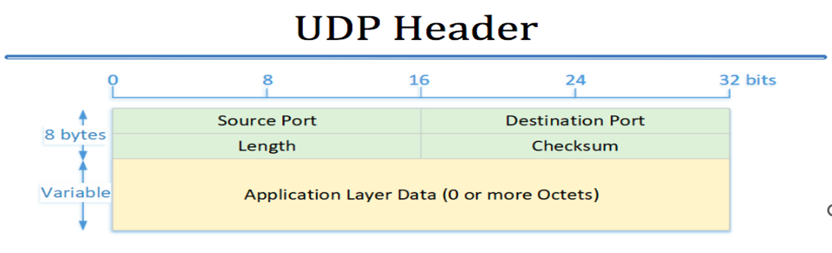
UDP HEADERS
Source Port(16 bits): This field identifies the sender’s port. Cleared to zero if not used.
Destination Port(16 bits):This field identifies the receiver’s port.
Length(16 bits): The length in bytes of the UDP header and the encapsulated data. The minimum value for this field is 8.
Checksum(16 bits) –
The checksum field may be used for error-checking of the header and data. This field is optional in IPv4, and mandatory in IPv6. The field carries all-zeros if unused. Needed with zero bytes at the end to make a multiple of two bytes. If the checksum is cleared to zero, then checksum is disabled. If the computed checksum is zero, then this field must be set to 0xFFFF.

Slide 38
UDP HEADERS
Source Port(16 bits): This field identifies the sender’s port. Cleared to zero if not used.
Destination Port(16 bits):This field identifies the receiver’s port.
Length(16 bits): The length in bytes of the UDP header and the encapsulated data. The minimum value for this field is 8.
Checksum(16 bits) –
The checksum field may be used for error-checking of the header and data. This field is optional in IPv4, and mandatory in IPv6. The field carries all-zeros if unused. Needed with zero bytes at the end to make a multiple of two bytes. If the checksum is cleared to zero, then checksum is disabled. If the computed checksum is zero, then this field must be set to 0xFFFF.

Slide 39
Genesis of IP Address
The Internet Corporation for Assigned Names and Numbers (ICANN) is responsible for creating IP addresses. This non-profit organization helps maintain the security and usability of the internet. A division of ICANN called the Internet Assigned Numbers Authority (IANA) mathematically produces and allocates all the IP addresses in existence.
Once IP addresses are created, the IANA assigns blocks of IP addresses to Regional Internet Registries (RIRs), which are in charge of allocating and registering IP addresses throughout various world regions.
These registries then lease out large blocks of IP addresses to large companies and Internet Service Providers (ISPs), who in turn lease smaller IP blocks out to businesses and individual consumers through their devices.

Slide 40
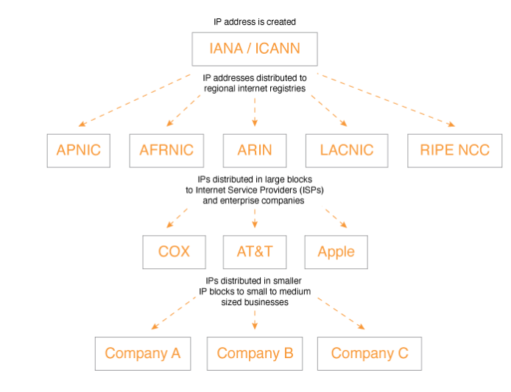
Distribution of IP Addresses

Slide 41
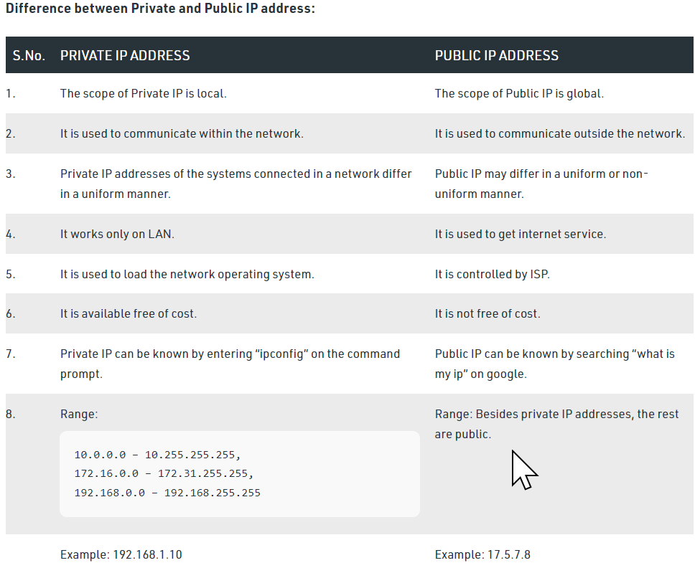
Type of IP Address
An IP address is a 32-bit or 128-bit number that uniquely identifies a host (computer or other device) on a TCP/IP network. There are two version IPV4 and IPV6.
Private IP address of a system is the IP address that is used to communicate within the same network (LAN).
Public IP address of a system is the IP address that is used to communicate outside the network. A public IP address is basically assigned by the ISP (Internet Service Provider).

Slide 42
Subnet Mask
The subnet mask is used by the TCP/IP protocol to determine whether a host is on the local subnet or on a remote network.
Example: Convert the IP address 192.168.2.158 into binary. If the subnet mask is 255.255.255.0 What is the network address.
NETWORK CLASS:
CLASS A:
CLASS B
CLASS C
CLASS D: ?
CLASS E: ?

Slide 43
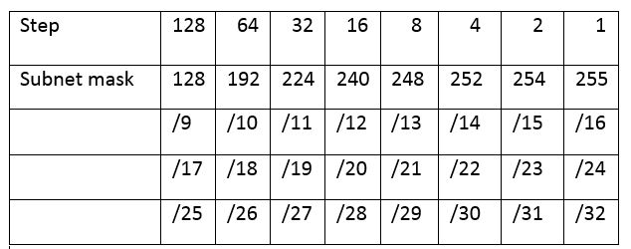
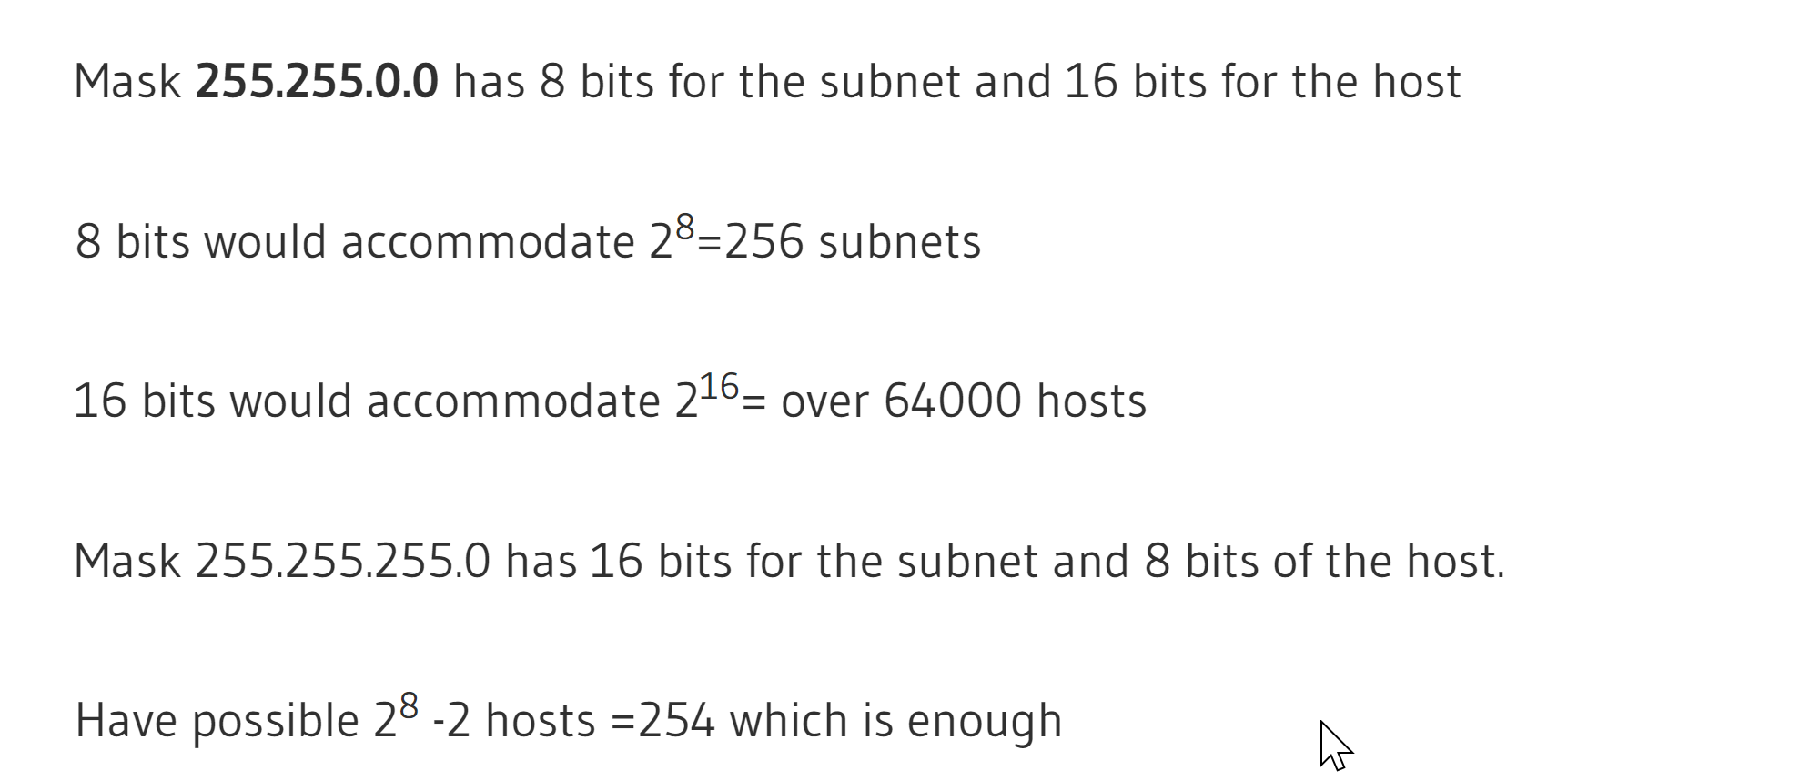
IP Subnetting
You have been allocated a class A network address of 29.0.0.0. You need to create at least 20 networks and each network will support a maximum of 160 hosts. Would the following two subnet masks Work?
255.255.0.0 and or 255.255.255.0
http://www.steves-internet-guide.com/subnetting-worked-examples/
https://subnetipv4.com/

Slide 44
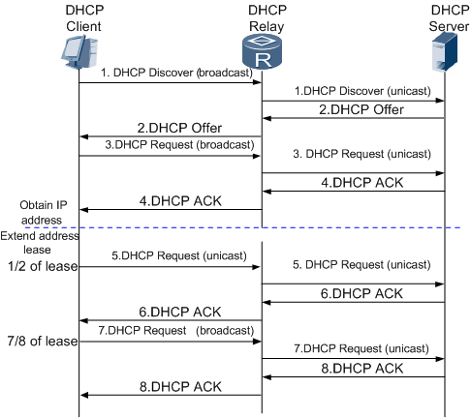
DHCP
DHCP (Dynamic Host Configuration Protocol) is a protocol used to provide quick, automatic, and central management for the distribution of IP addresses within a network. DHCP is also used to configure the proper subnet mask, default gateway, and DNS server information on the device.
HOW IT WORKS
Discover - Client broadcasts a message to discover a DHCP server
Offer - DHCP servers offer an IP address
Request - Client selects an offer and formally requests to use the IP
Acknowledge - The Server formally allocates the IP (and options) to the client
Windows command to release and renew IP address?

Slide 45
Summary
Introduction to Networking
Network Implementations
Network Topologies
Ports, Protocols, Sockets & IP Addressing
Reference Models

